Slide 1
TIBCO Cloud Integration v 1.0.0 and BusinessWorks Container Edition v1.0.0
Presented By
Bharathiraja Tamilselvan [BT]
btamilselvan@prokarma.com
Prokarma Inc.

Slide 2
Agenda
Cloud Concepts & Characteristics
Cloud Solution - Challenges
Product Overview
TIBCO Cloud Integration
TIBCO BusinessWorks Container Edition
Product Features
TIBCO Cloud Product Stack
Questions

Slide 3
Cloud Concepts & Characteristics
Characteristics-
On-demand self-service
Resource pooling
Rapid elasticity
Measured Service
Broad network Access
Core Concepts-
IaaS, PaaS & SaaS
API & APM
Microservices
Public Cloud/Private Cloud/Hybrid Cloud
Cloud Native

Slide 4
Cloud Solution - Challenges
Security and Privacy
Service Delivery and Billing
Reliability and Availability
Interoperability and Portability
Time to market solutions in Cloud native
Devops world – Rapid development and quick life cycle path.

Slide 5
Product Overview – TIBCO Cloud Integration
Connects applications in pure cloud or hybrid cloud.
Model, Create, Design, Test and Deploy API’s
Runtime consistency across entire integration flow in highly distributed environment.

Slide 6
TIBCO Cloud Integration - Features
Code less development – similar to other TIBCO integration products
Push to cloud & Publish to TIBCO Mashery – in single click
API Modeler Tool – to understand API Operational Parameters and Structure
Swagger Support – helps in well documented and easy testing even before implementation
Microflows – Ensure runtime consistency by providing transformations, routing, throttle, caching, etc.
Microflow is creating consumer specific contract for an application. It isolates app-facing API from backend service and allows single backend.
Command Line and Web interface – push, view, configure, scale, remove app.
Plugin Supported – Salesforce.com, ServiceNow, Marketo, Microsoft Dynamics, NetSuite, Workday.

Slide 7
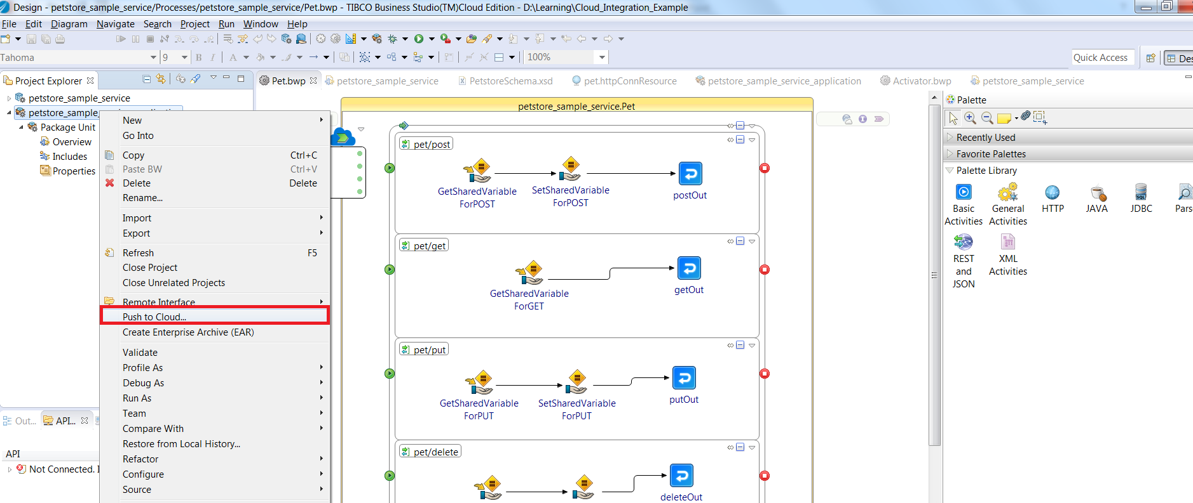
TIBCO Cloud Integration – Design Time

Slide 8
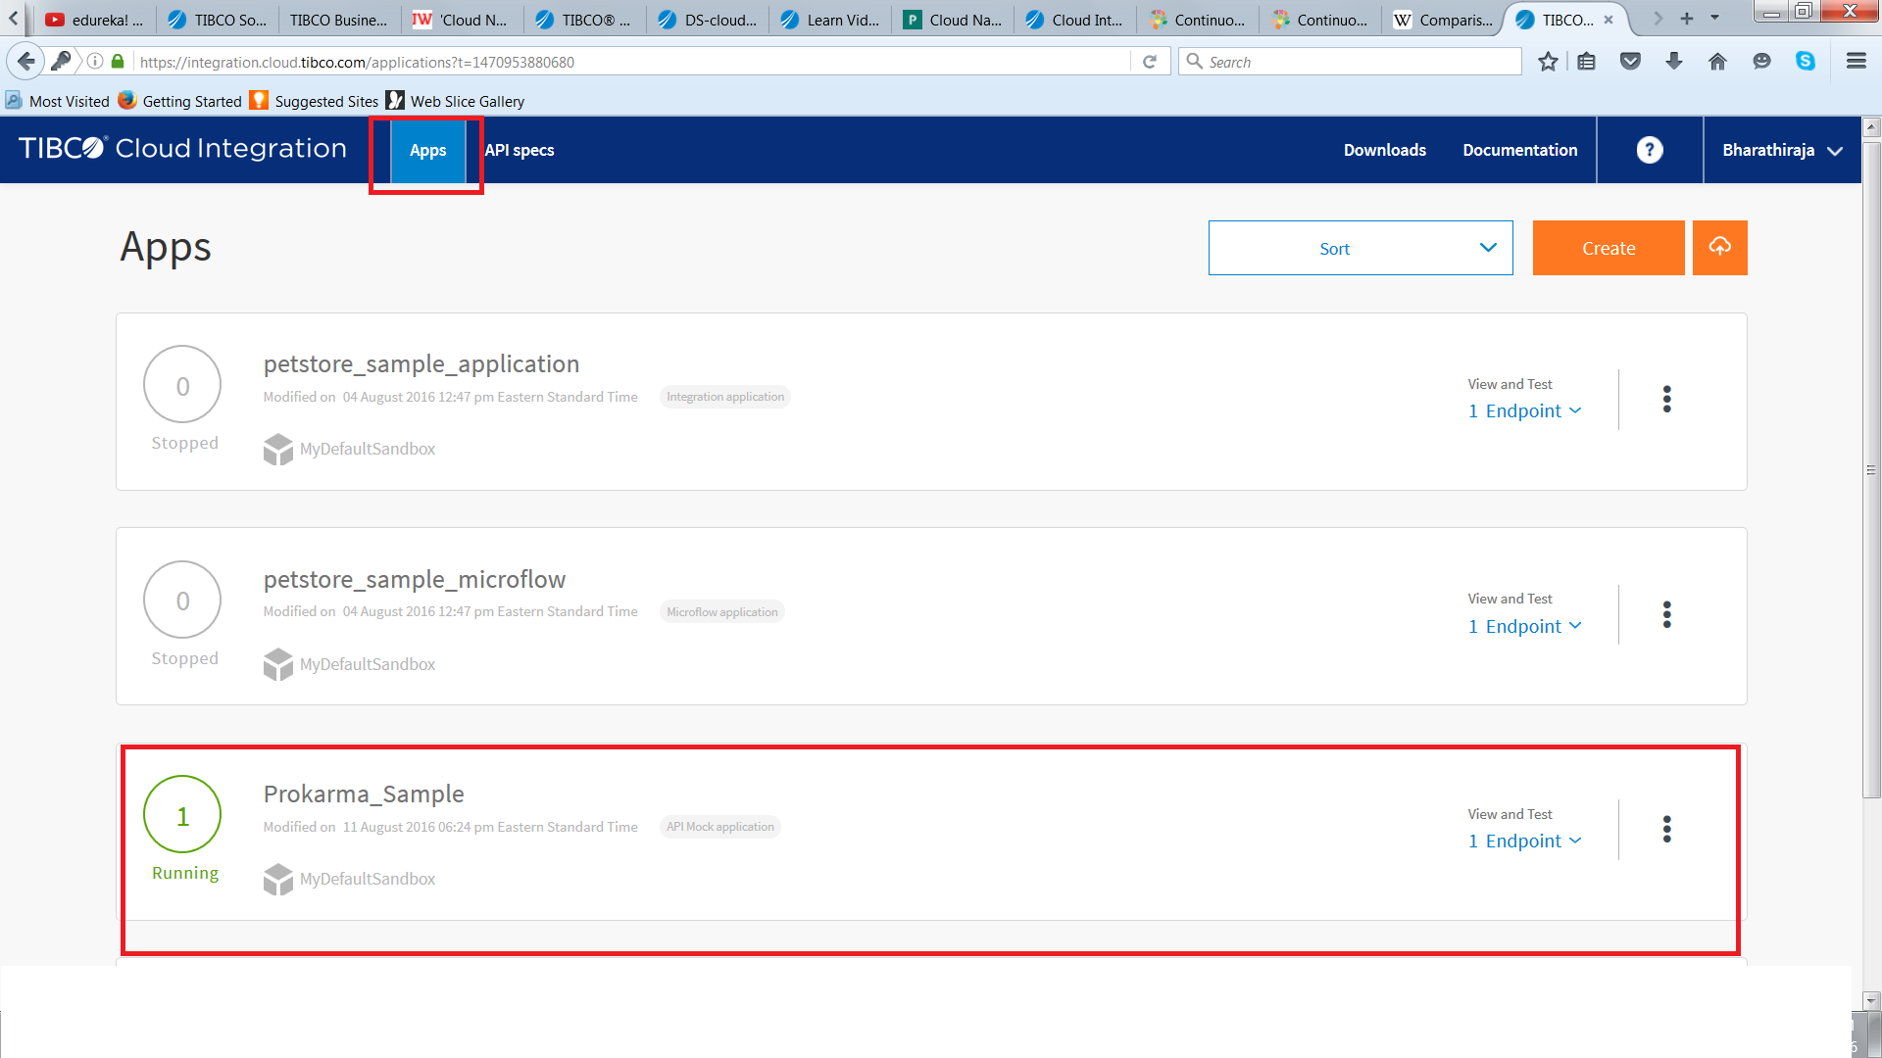
TIBCO Cloud Integration – Web Interface

Slide 9
Product Overview – TIBCO BW Container Edition
Brings BusinessWorks integration capability to Cloud native application integration.
Tool for enterprise Platform as a Service (ePaaS) solution.
Quick Microservices design (Node/Java/python)
Integrate API’s with zero lines of code
Deploy, manage & scale using Pivotal Cloud foundry

Slide 10
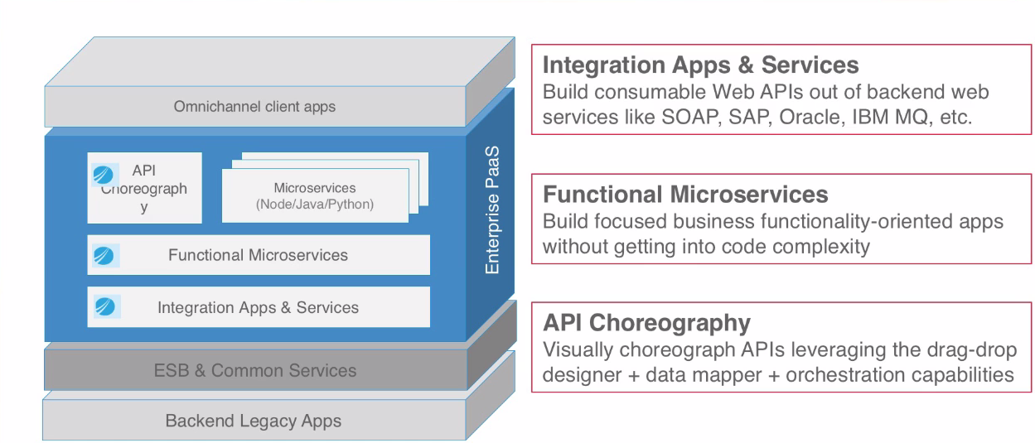
BW Container Edition – Solution Area
Source: TIBCO Webinar

Slide 11
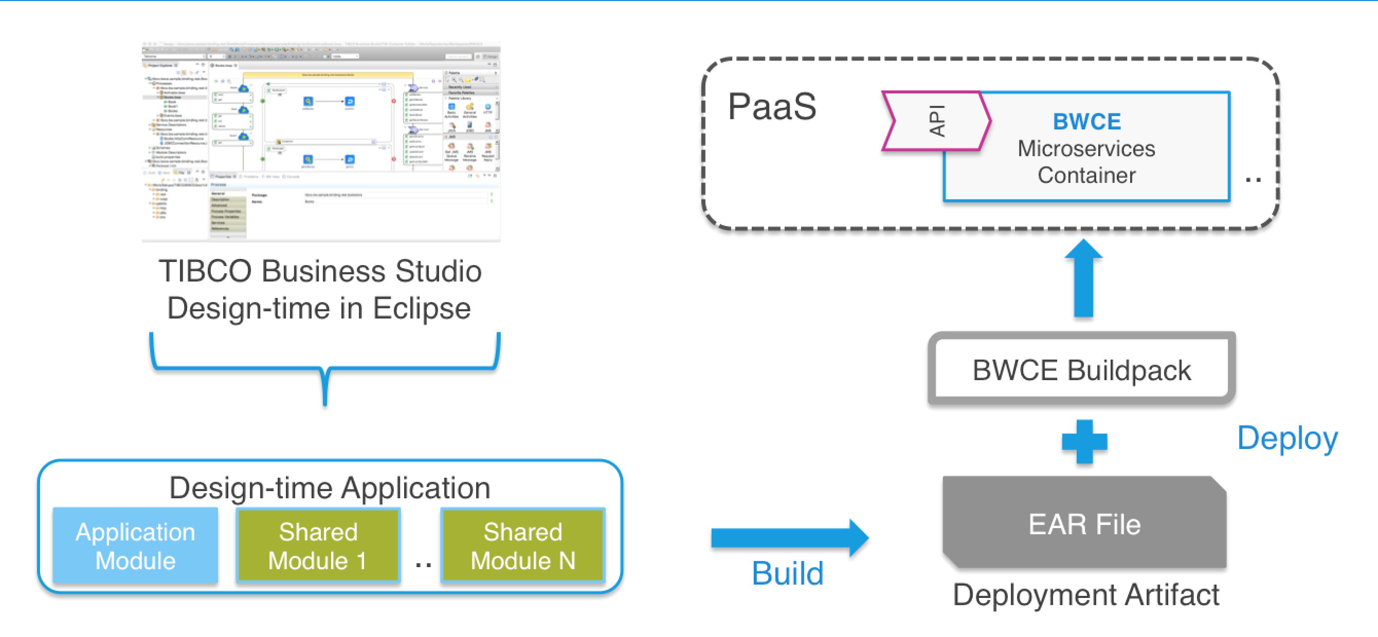
BW Container Edition – Life Cycle Components
Source: TIBCO Documentation

Slide 12
TIBCO BW Container Edition - Features
BWCE (v1.0.0) = TIBCO ActiveMatrix BW 6.0 (without File Palette) + build pack + Cloud Foundry
Customizable build Pack scripts to include needed tools/plug-ins/jars during runtime.
Build Script Location : http://github.com/TIBCOSoftware/bwce-buildpack
Support only PaaS container -Pivotal Cloud Foundry

Slide 13
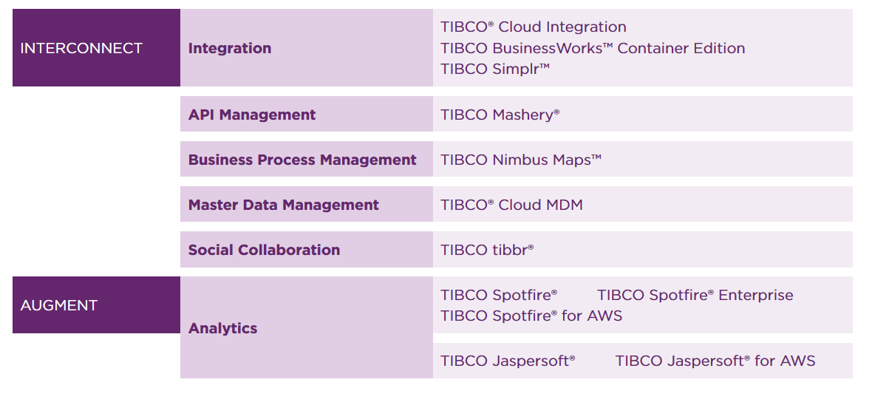
TIBCO Cloud Product Stack

Slide 14
Questions

